Slide 1
R package: flp12D
108021186 張致語

Slide 2
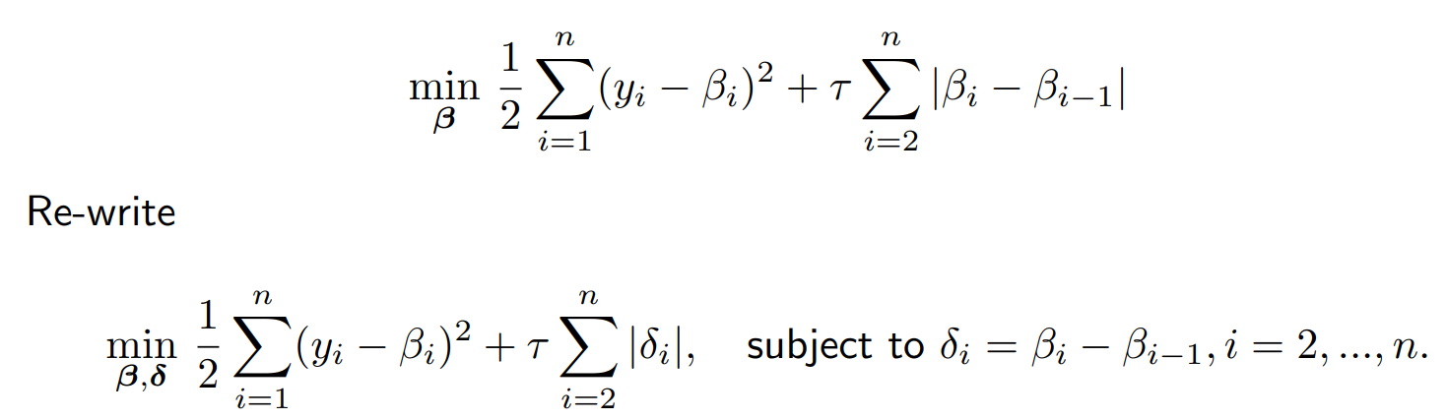
1 dimension fussed lasso problem
The example defined in class

Slide 3
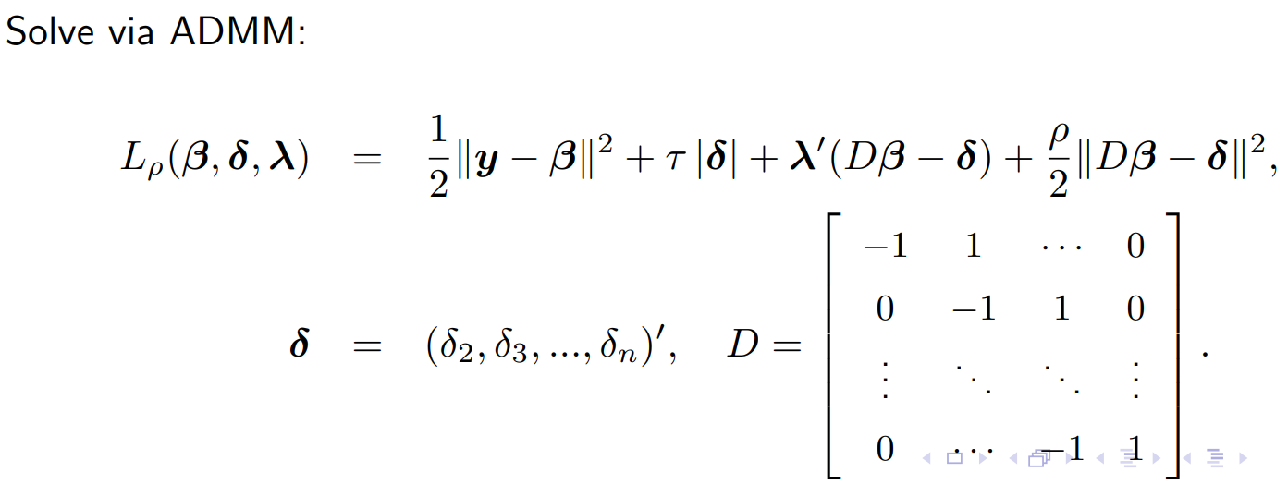
1 dimension fussed lasso problem
The solution of this problem

Slide 4
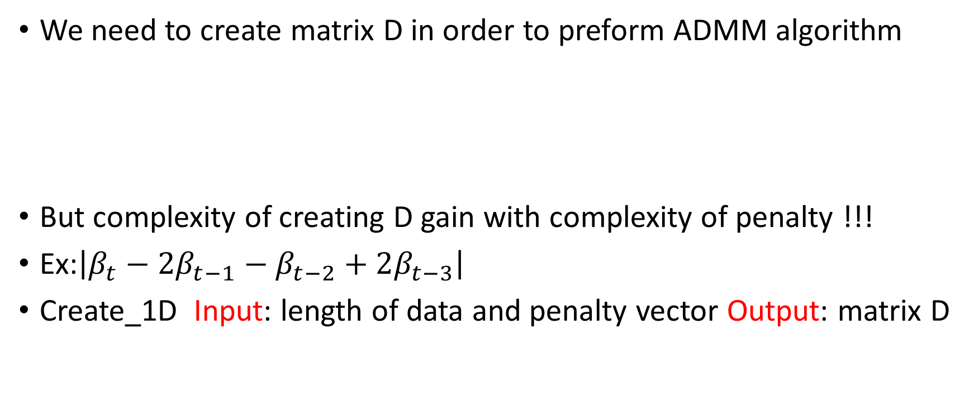
1 dimension fussed lasso problem
We need to create matrix D in order to preform ADMM algorithm
But complexity of creating D gain with complexity of penalty !!!
Ex:$\left|β_{t}−2β_{t−1}−β_{t−2}+2β_{t−3}\right|$
Create_1D Input: length of data and penalty vector Output: matrix D

Slide 5
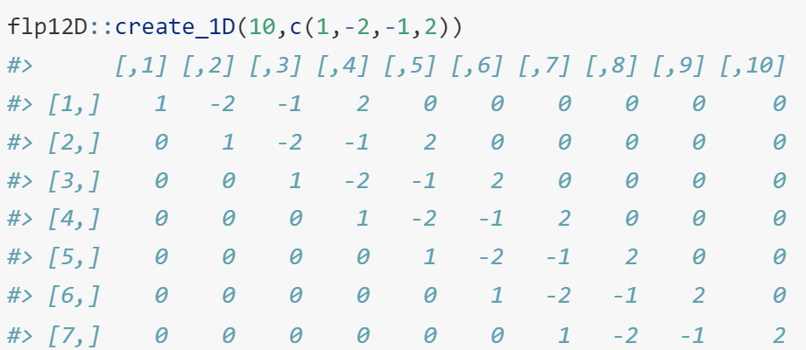
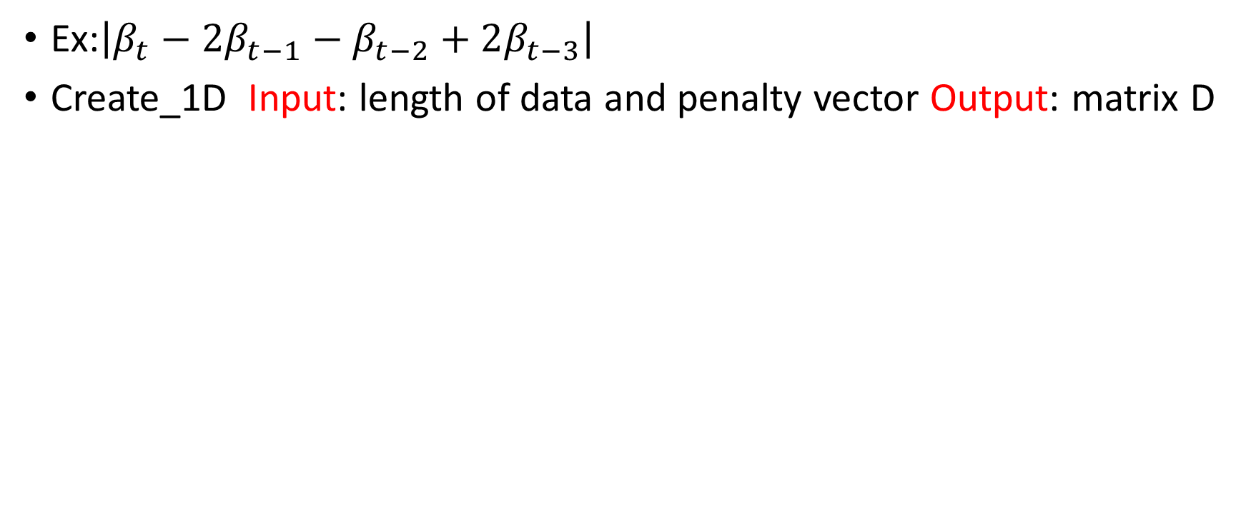
1 dimension fussed lasso problem
Ex:$\left|β_{t}−2β_{t−1}−β_{t−2}+2β_{t−3}\right|$
Create_1D Input: length of data and penalty vector Output: matrix D

Slide 6
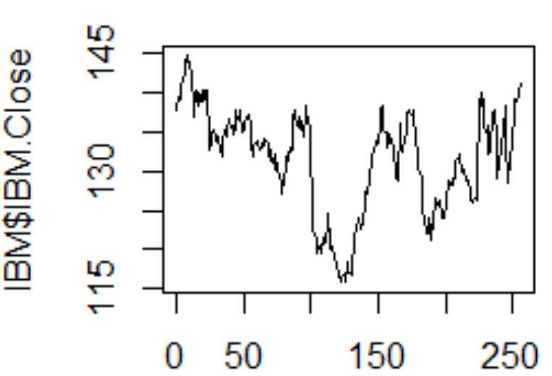
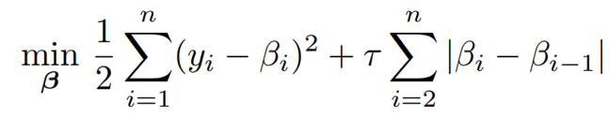
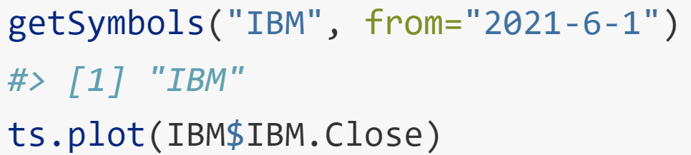
1 dimension fussed lasso problem
With matrix D, we can solve the problem using ADMM algorithm
flp_1D
Input: penalty vector/data/tao/rho/iteration/error
Output: estimator beta/lambda/delta/loss/error
Ex:
Data set: stock price of YAHOO from 2021/6/1

Slide 7
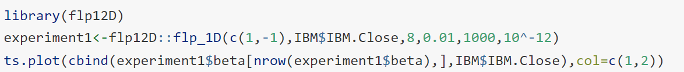
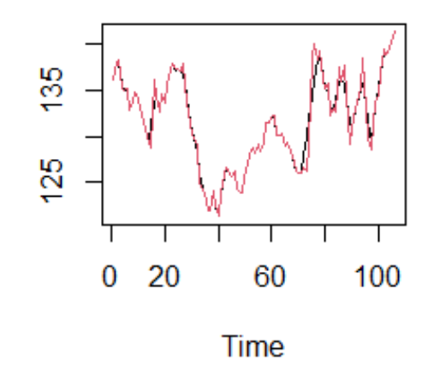
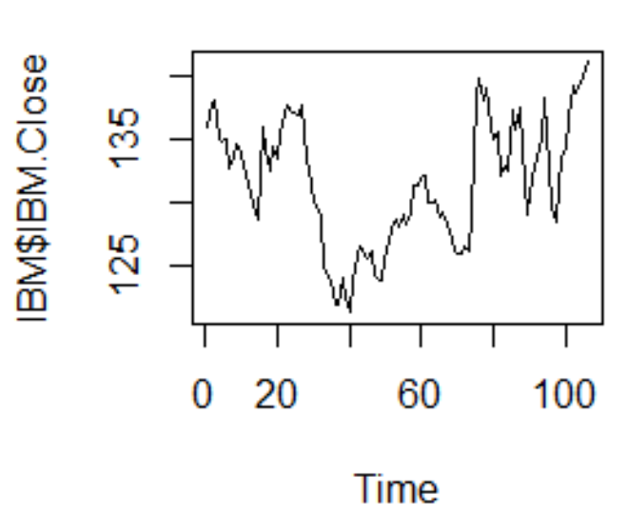
1 dimension fussed lasso problem
flp_1D

Slide 8
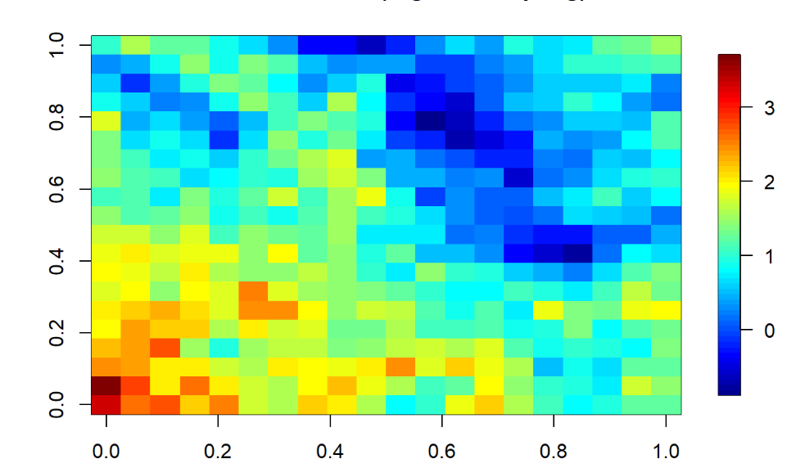
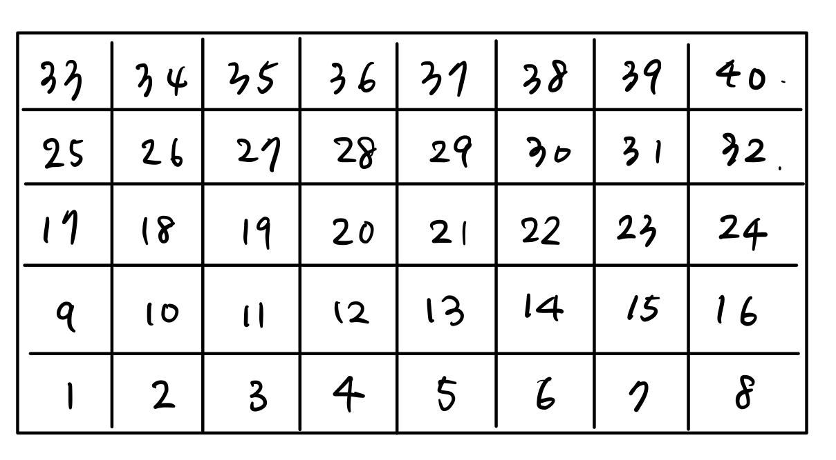
2 dimension fussed lasso problem
How about the two dimension data?

Slide 9
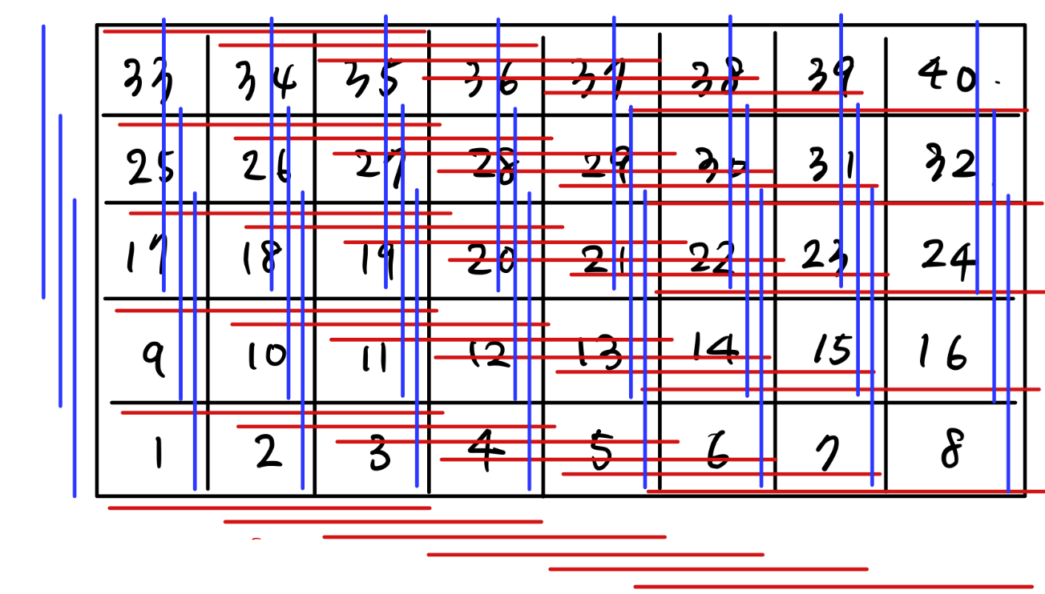
2 dimension fussed lasso problem
We can do penalty on both x and y axis !!!
Create matrix D becomes more complicated
Create_2D
Input: dim(n,r,c) / UD / LR
Output: matrix D

Slide 10
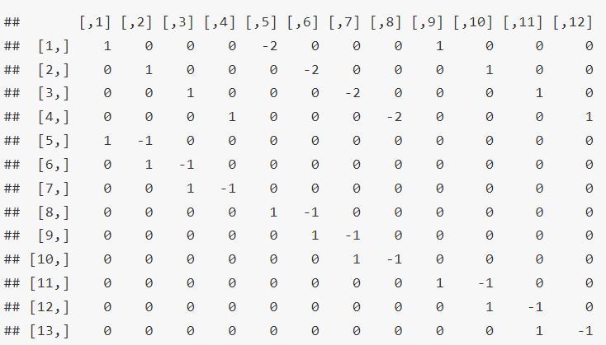
2 dimension fussed lasso problem

Slide 11
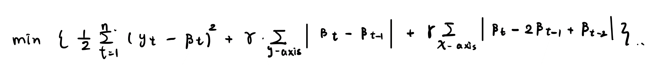
2 dimension fussed lasso problem
Similarly with matrix D, we can solve the problem using ADMM algorithm
flp_2D
Input: UD/LR/r/c/data/tao/rho/iteration/error
Output: estimator beta/lambda/delta/loss/error
Ex:

Slide 12
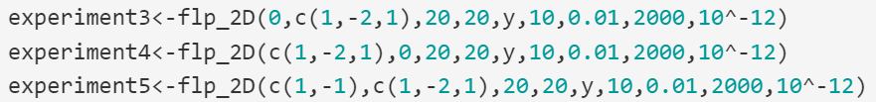
2 dimension fussed lasso problem
flp_2D
Experiment3: only do penalty on x axis
Experiment3: only do penalty on y axis
Experiment3: do penalty on both x and y axis

Slide 13
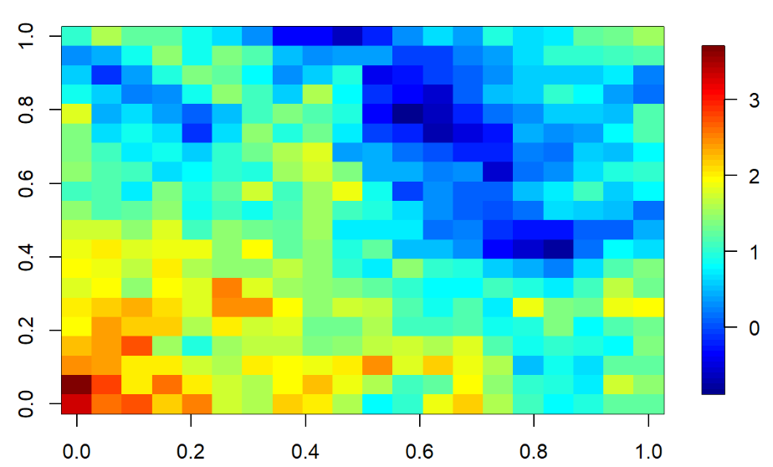
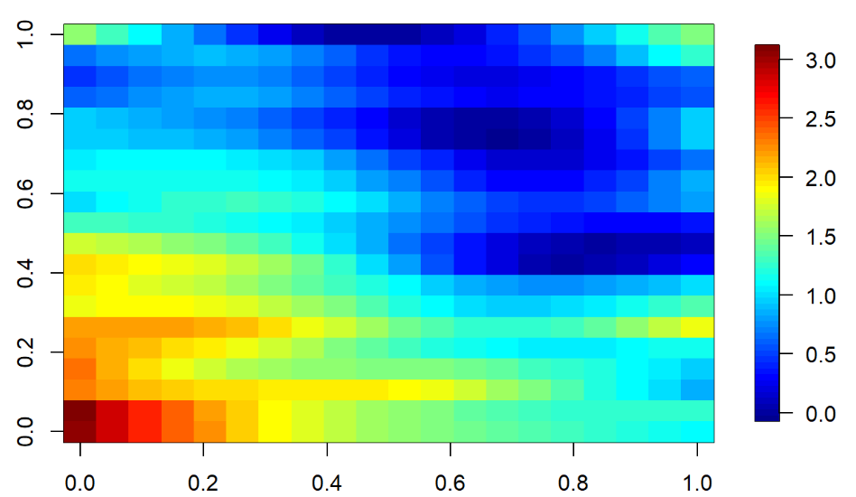
2 dimension fussed lasso problem
Y do penalty on x axis

Slide 14
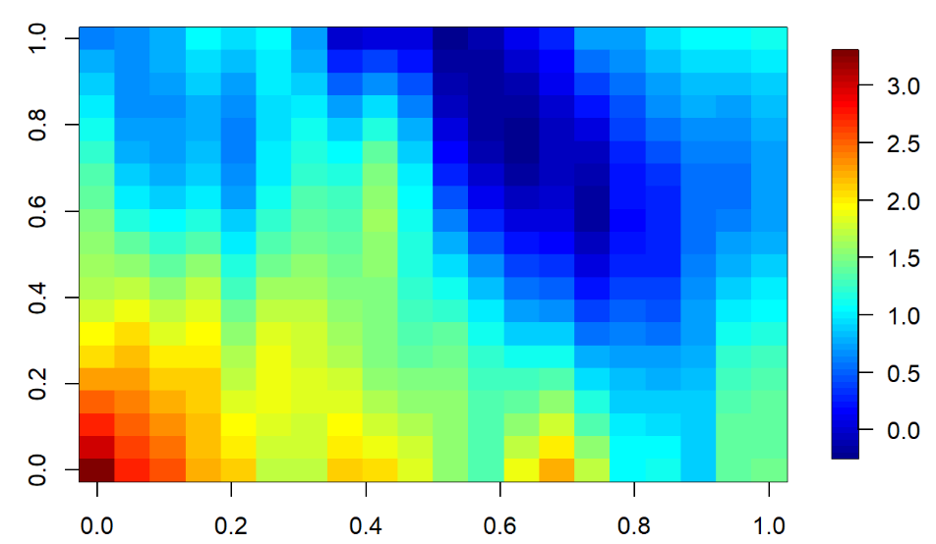
2 dimension fussed lasso problem
Y do penalty on y axis

Slide 15
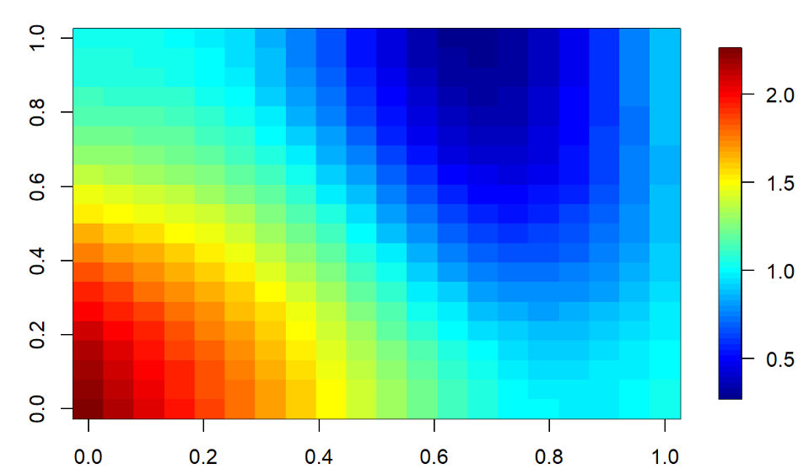
2 dimension fussed lasso problem
Y do penalty on x and y axis

Slide 16
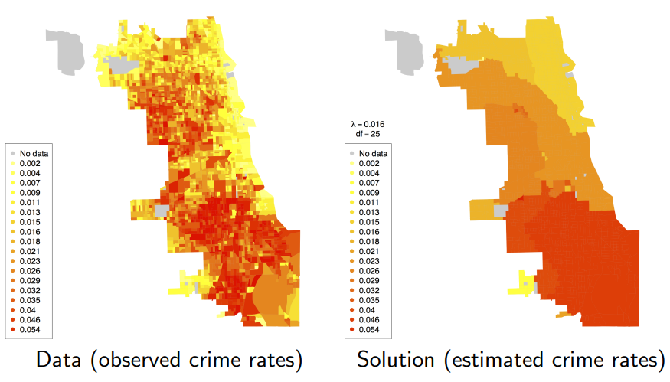
2 dimension fussed lasso problem
Application

Slide 17
2 dimension fussed lasso problem
Reference
1. Case Study: Generalized Lasso Problems
https://www.stat.cmu.edu/~ryantibs/convexopt-S15/lectures/19-case-study-genlasso.pdf
2. Statistical computing lecture note offered by Nan-Jung Hsu at NTHU
Materials
1.R markdown file: https://reurl.cc/QLmYYb
2.flp12D package: https://reurl.cc/VD7YWN

